Slide 1
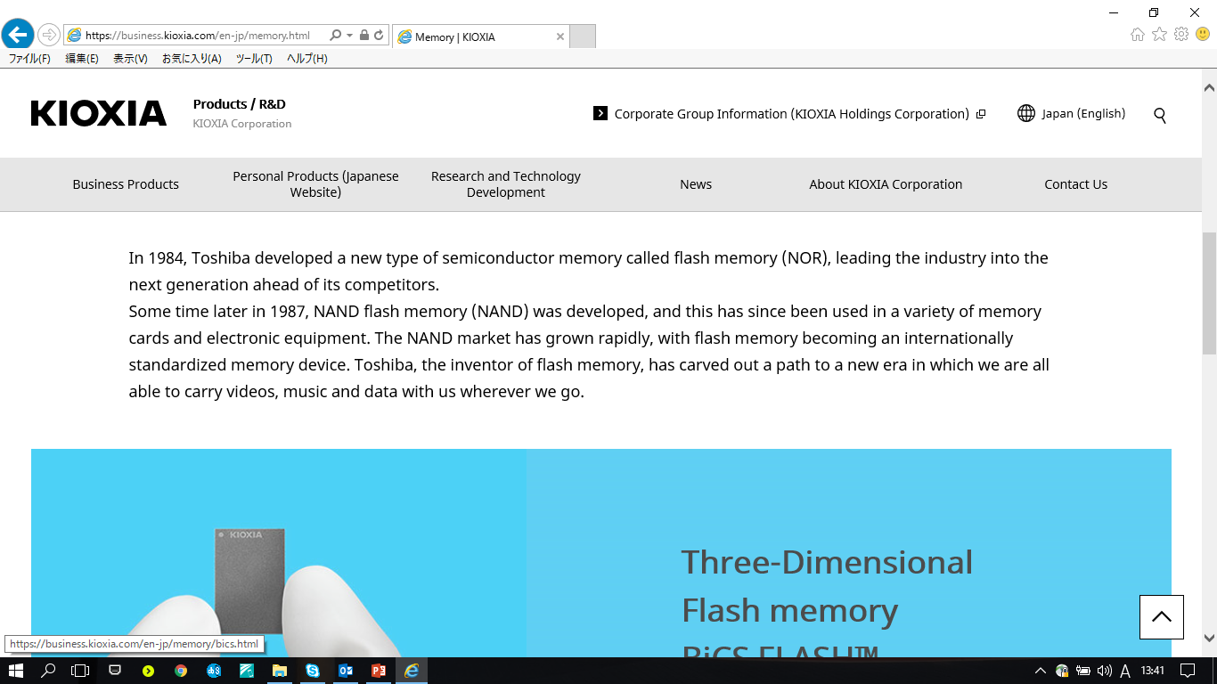
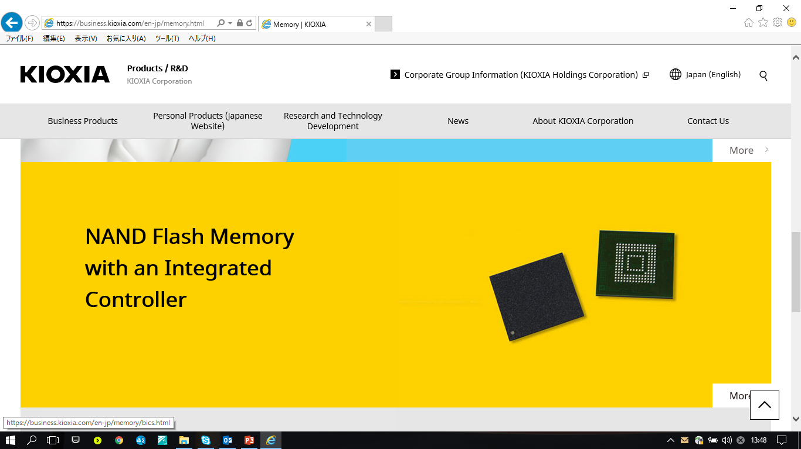
/region/top/business/memory.html
Flash Memory
Then various flash memory such as NAND flash and BiCS FLASH™ were developed, and these have been used in a variety of memory cards and electronic equipment. The flash memory market has grown rapidly, with flash memory becoming an internationally standardized memory device. KIOXIA, the inventor of flash memory……we go.

Slide 2
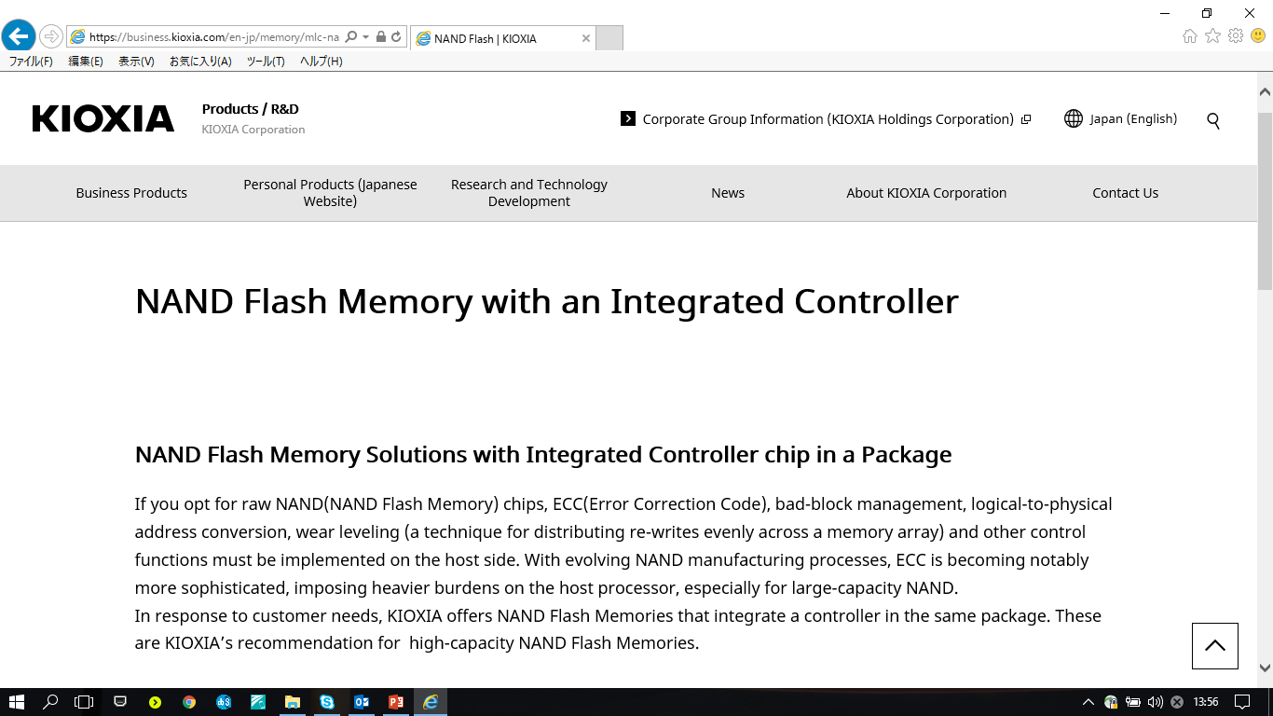
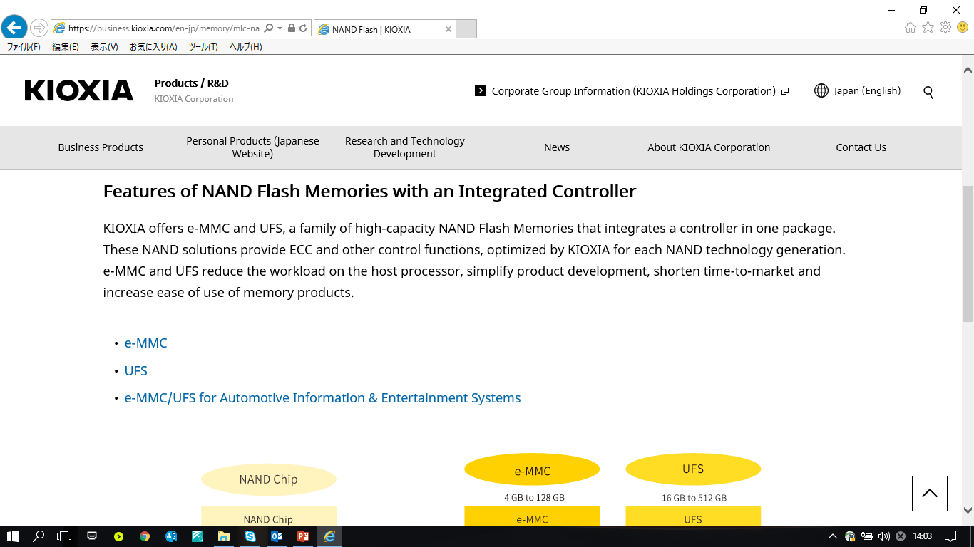
/region/top/business/memory/mlc-nand.html
Flash Memory with an Integrated Controller
Flash Memory Solutions with Integrated Controller Chip in a Package
If you opt for raw Flash Memory chips, ECC……. With evolving Flash Memory manufacturing process…especially for large-capacity Flash Memory. In response to customer needs, KIOXIA offers Flash Memories that integrate a controller in the same package. These are KIOXIA’s recommendation for high-capacity Flash Memories
Features of Flash Memories with an Integrated Controller
KIOXIA offers e-MMC and UFS, a family of high-capacity Flash Memories that integrates a controller in one package. These Flash Memory solutions provide ECC and other control functions, optimized by KIOXIA for each Flash Memory technology generation.

Slide 3
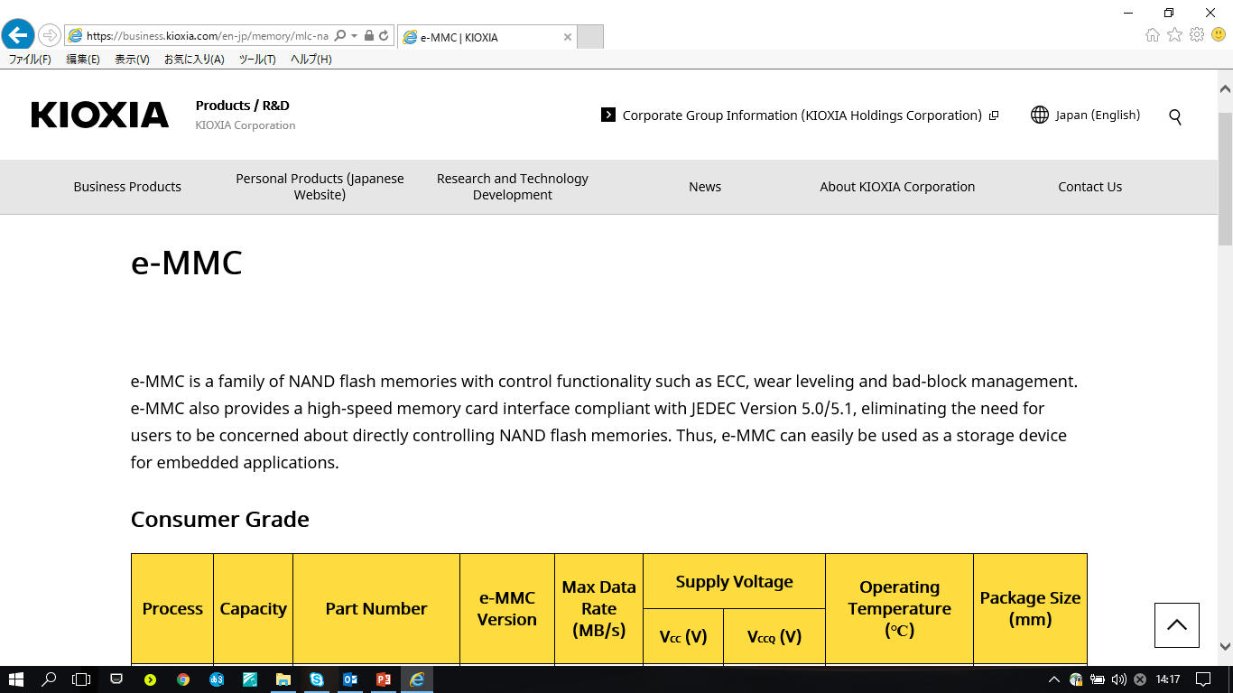
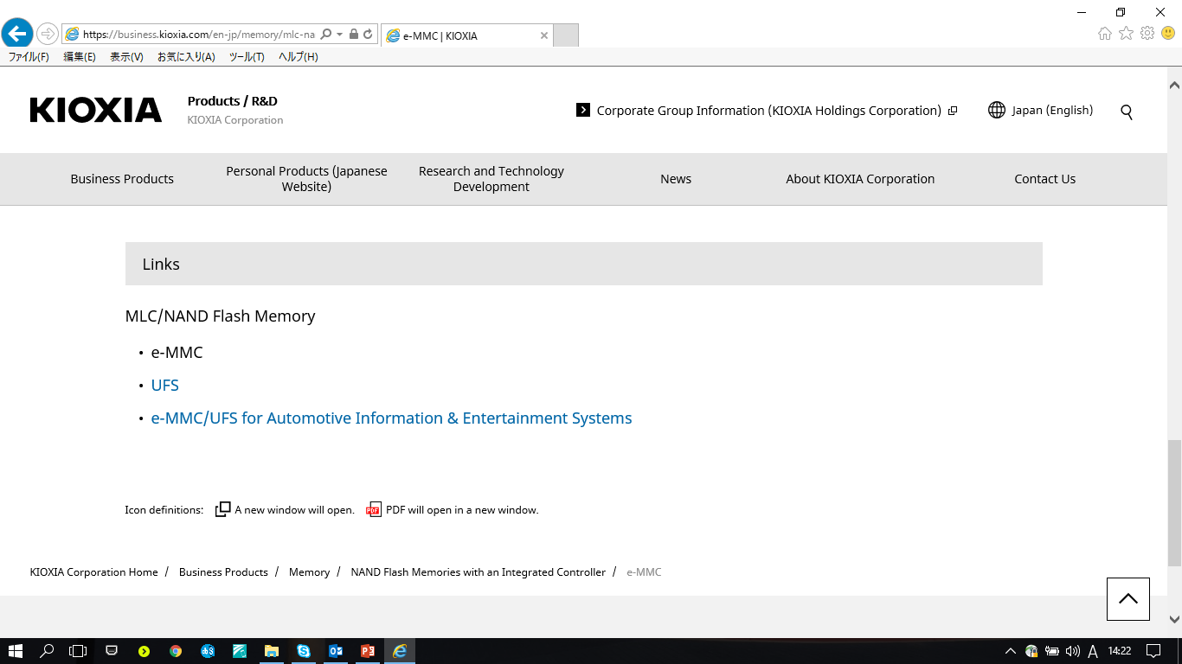
/region/top/business/memory/mlc-nand/emmc.html
Flash Memories
Flash Memory with an Integrated Controller

